Slide 1
Sarvajanik College of Engineering and Technology
Department of Information and Technology
Subject: Project-I Code: BTIT16701
CryptoTradex: AI-Integrated Cryptocurrency Trading Platform
Presented By:
Arham Shah [ET22BTIT003]
Dave Dhruv [ET22BTIT016]
Desai Parth [ET22BTIT019]
Godhani Neel [ET22BTIT037]
Veer Shekhda [ET23BTIT811]
Supervised By:
Prof. Mukesh Patel
(Dept. of I.T.)

Slide 2
CryptoTradeX is a secure, scalable, and user-friendly cryptocurrency trading platform.Built to simplify crypto trading for both beginners and advanced traders, ensuring smooth user experience and robust security.
It integrates AI-powered chat assistance, real-time market insights, and advanced wallet features into a unified ecosystem.
Relevance:
-- Global crypto adoption is expected to exceed 560 million users in 2025,with
India ranking among the top countries in adoption.
-- Most existing platforms overwhelm users with complexity; 70% of new investors report difficulty in understanding crypto interfaces.
-- Security incidents like exchange hacks and wallet breaches highlight the urgent need for strong, multi-layered protection.
Introduction

Slide 3
Problem Definition
For beginners, most crypto platforms feel like stepping into a spaceship cockpit — complex, overwhelming, and intimidating.
Existing exchanges (Binance, Coinbase, WazirX) are powerful, but not beginner-friendly.
Limited real-time data integration leaves users unsure if they’re seeing the full market picture.
No AI assistant to explain trends or answer instant queries in simple language.
Wallet functions are scattered across multiple apps → trading, transfers, and tracking feel disconnected.
The gap: Crypto should democratize finance, but current tools often confuse or exclude new users.

Slide 4
Motivation
Increasing adoption of cryptocurrencies in India and globally creates demand for simpler, smarter platforms.
Users struggle with information overload, scattered tools, and lack of guidance in existing exchanges.
Security breaches in exchanges highlight the need for strong authentication and safe wallet management.
Our motivation: To build a secure, AI-assisted, and beginner-friendly trading ecosystem that combines trading, portfolio tracking, and wallet management seamlessly.

Slide 5
Methodology
Approach & Technologies :
Frontend: React, Tailwind CSS, Redux, React Router DOM, Shadcn UI → ensures responsive, modern interface.
Backend: Spring Boot, MySQL, Spring Security, Java Mail Sender → secure, scalable server-side management.
APIs: Gemini API, CoinGecko API → provide live crypto prices, historical data, and market analytics.
Payments: Razorpay, Stripe → enable secure fiat-to-crypto transactions.
System Flow:
1. Architecture Diagram
2. Sequence Diagram
3. Data Dictionary
4. Use Case Diagram
5. Data Flow Diagram (DFD)

Slide 6
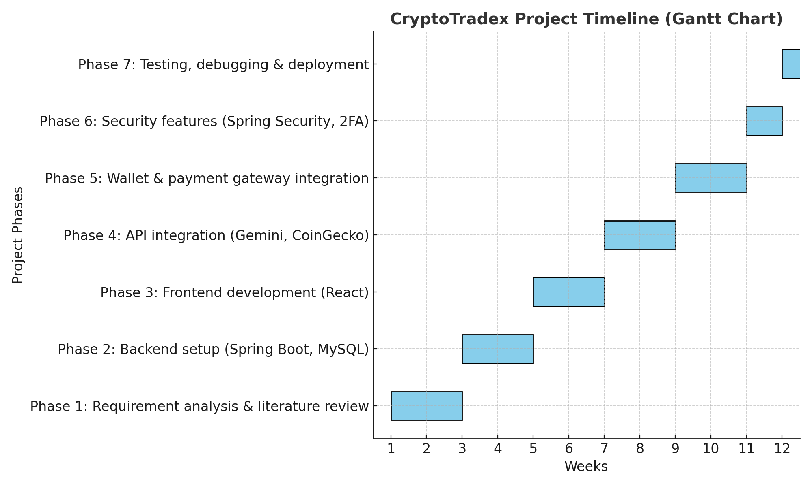
Timeline Chart for Project Work

Slide 7
Expected Outcome
User-Centric Platform: Simplifies crypto trading for both beginners and experts.
AI Assistance: Provides instant, data-backed crypto insights for informed decisions.
Comprehensive Wallet: Unified solution for transfers, withdrawals, deposits, and history tracking.
Enhanced Security: Multi-layered authentication to safeguard assets.
Market Relevance: Bridges gap between traditional exchanges and smart AI-driven platforms.
Impact: Helps democratize cryptocurrency trading in India with transparency, security, and accessibility.

Slide 8
References
Data & External APIs :-
CoinGecko: For comprehensive cryptocurrency data, charts, and market information.
Link: https://www.coingecko.com/
Gemini: For exchange data, API services, and market insights.
Link: https://www.gemini.com/
Diagramming & Charting Tools :-
Eraser: Used for creating diagrams, wireframes, and architectural visuals.
Link: https://www.eraser.io/
Mermaid Chart: For generating diagrams and flowcharts from text-based code.
Link: https://www.mermaidchart.com/
Payment Gateways :-
Razorpay: For processing payments, particularly within the Indian market.
Link: https://razorpay.com/
Stripe: For global payment processing and financial infrastructure.
Link: https://stripe.com/

